Slide 1



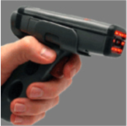



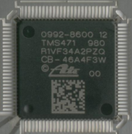
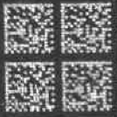
WW AutoTrack 2007
Dan Wikander
Collaborative Technology Enablement
- Industry Standards
- Customer Specs & Initiatives
- Equipment/Materials Supplier
- TI Supply Chain (SAP AutoTrack System)
Track>Trace>Contain>Recover

Slide 2
WW AutoTrack 2007
Dan Wikander
Collaborative Technology Enablement
Industry Standards & Guidelines
(1D/2D Symbology & Data Identifiers)
  NEDA (National Electronics Distributors Assn.)
  ANSI MH10 Industry Standards
Other Industry Initiatives
  Counterfeit Trace Detection & Prevention
  China/EU RoHS & JEDEC Pb-Free/Moisture Data

Slide 3
WW AutoTrack 2007
Dan Wikander
Collaborative Technology Enablement
Equipment/Materials Suppliers
  ??? – Printers, Labels, Ribbon
  ??? – 1D Barcode & 2D Matrix CMOS Scanners
  Cognex – New Scanners developed for 2D Die scanner
  (Not a TI endorsement but shared due to MH10 participation & only known
  source of single scanner solution)
  ??? – 2D Quality Verifier (for 2D part marking)

Slide 4
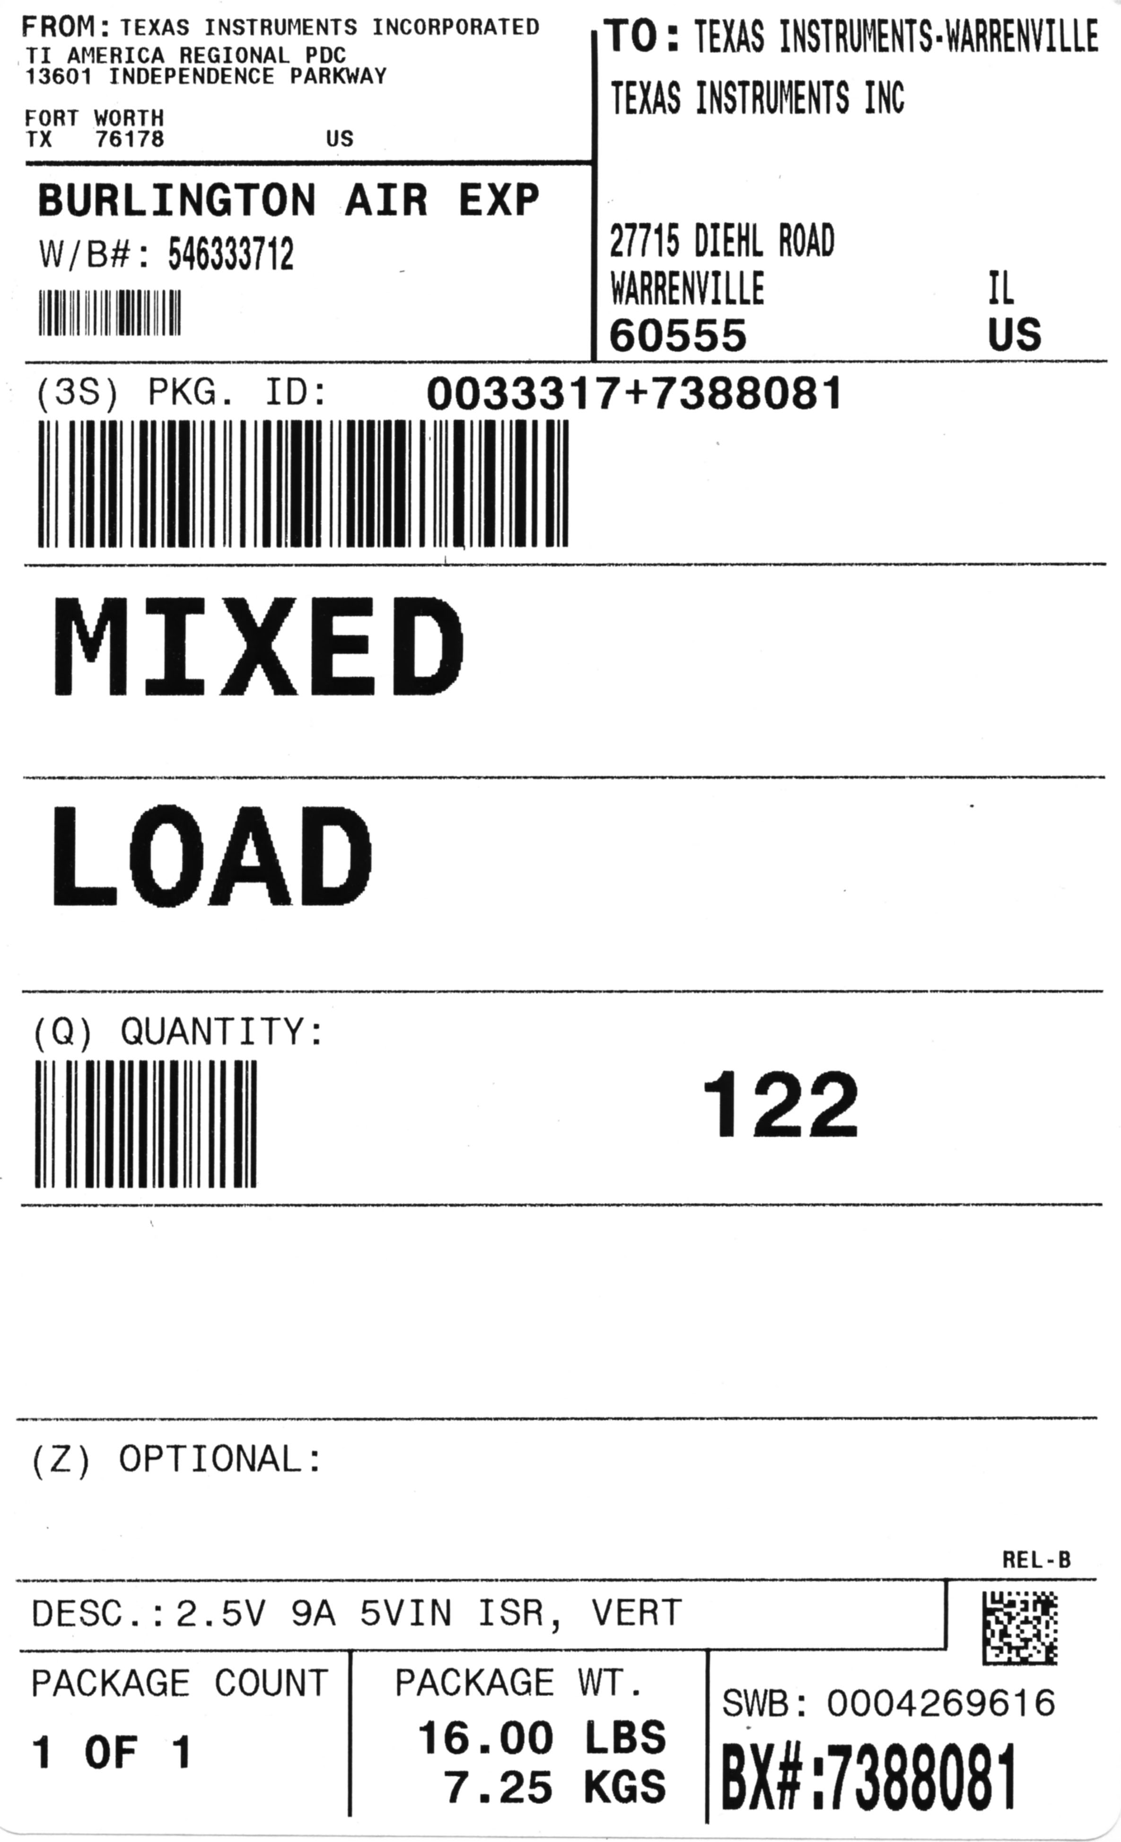
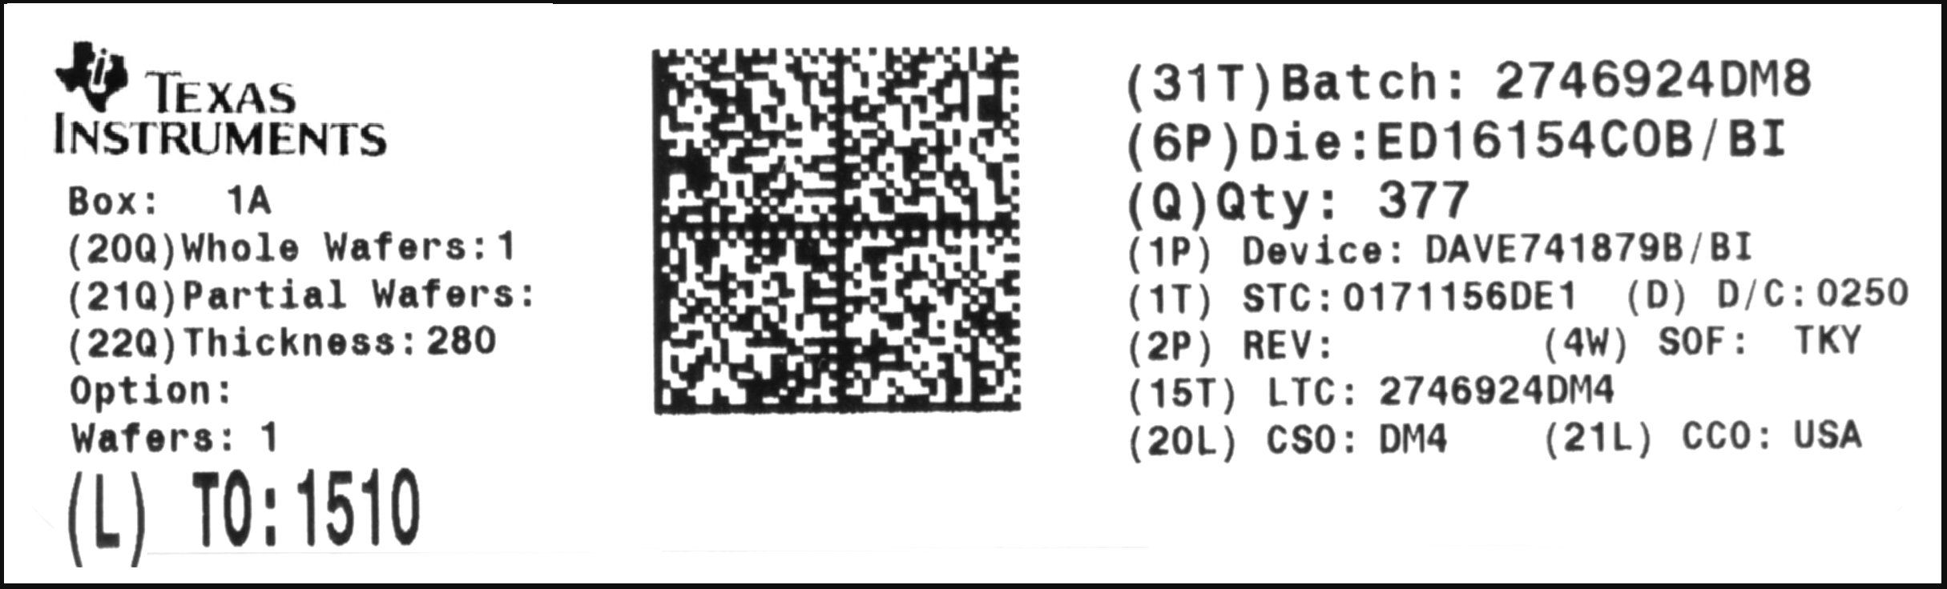
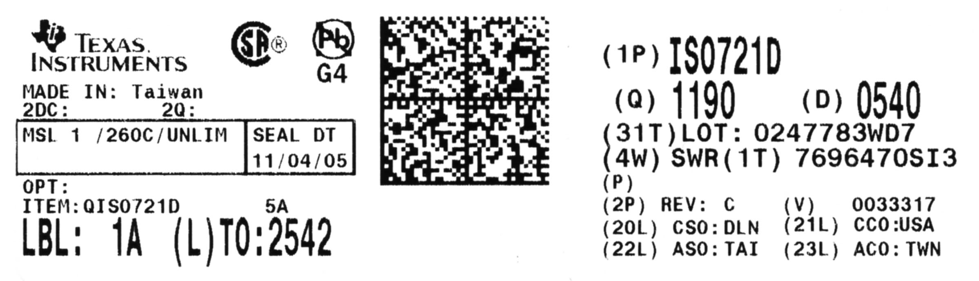
WW AutoTrack 2007
Dan Wikander
Collaborative Technology Enablement
TI Supply Chain (SAP AutoTrack System)
Track>
  SAP Fab, A/T, & Ship Labeling
Fab Label
2D Die Tracking
A/T Label
2D Device Tracking

Slide 5
WW AutoTrack 2007
Dan Wikander
Collaborative Technology Enablement
TI Supply Chain (SAP AutoTrack System)
Trace>
  SAP Genealogy & Product Attributes (ZGTS)
  - Real-time updates/access, 10-years on line
  - Used by Fabs, A/Ts, Business Planners & Customer
  Quality Engineers
  - Critical step in containment & counterfeit detection
  - Data source for CC+ (PDC Inventory, Ship, & Scrap
  by product attributes (to smallest container)

Slide 6
WW AutoTrack 2007
Dan Wikander
Collaborative Technology Enablement
TI Supply Chain (SAP AutoTrack System)
Contain>
  SAP QA Hold & Release system
  - Used by Fabs, A/Ts, Business Planners and
  Customer Quality Engineers
  - Can contain by Product, product/site combination,
  or Lot attributes

Slide 7
WW AutoTrack 2007
Dan Wikander
Collaborative Technology Enablement
TI Supply Chain (SAP AutoTrack System)
Recovery>
  Horizon project to support more efficient RMR-Rework
  process for PDCs & A/Ts. Also Automotive, Medical, &
  Storage Products initiative for handling and forming
  rework lots.

Slide 8
BACK-UP SLIDES

Slide 9
TQ (Transport Queue)/AutoTrack
- SAP Custom Module -
TQ/AutoTrack Functions
Fab
Packing
Labeling
Demand Match
Wafer Map
STO Create
Waybill Create
Shipping Unit
Shipping Labels
QA Hold/Release
Genealogy Reporting
A/T
Packing
Labeling
Residual Mgmt
Demand Match
STO Create
Delivery Create
Waybill Create
Shipping Units
Shipping Labels
Delivery Print
QA Hold/Release
Genealogy Reporting
PDC
Pick
Customer Labels
Repack
Delivery Assign
Waybill Create
Shipping Units
Shipping Labels
QA Hold/Release
Genealogy Reporting
LBE/Make Plng
Supply-Demand Mgmt
LBE/Make Quality
Trace-Contain-Release
TQ/Auto-Track

Slide 10
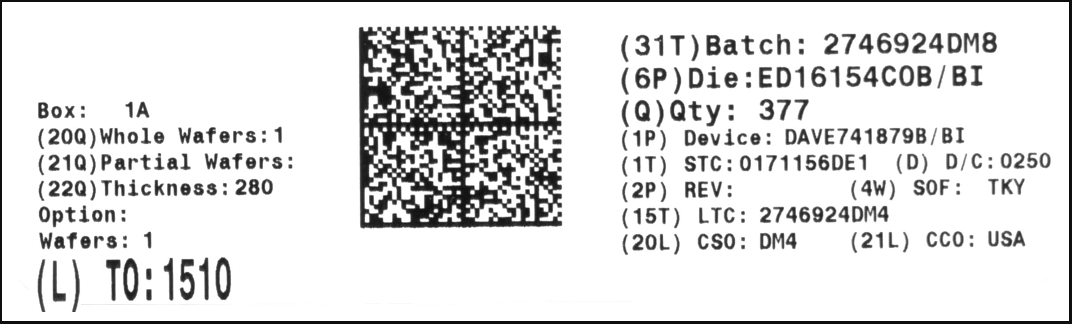
Overview
TQ (Transport Queue)/AutoTrack
- SAP Custom Module -
1.2” x 4”
2D barcode
Data (printed/stored)
  Total Number of Wafers
  Die Thickness
  Option Text
  Wafer Numbers
  Ship To
  SAP Batch
  Die Name
  GEC Quantity
  SMS Item ID
  STC (‘License Plate’)
  Date Code
  Die Revision
  State of Finish (SOF)
  FABLTC
  CSO
  CCO
Pack Label (Wafer)

Slide 11
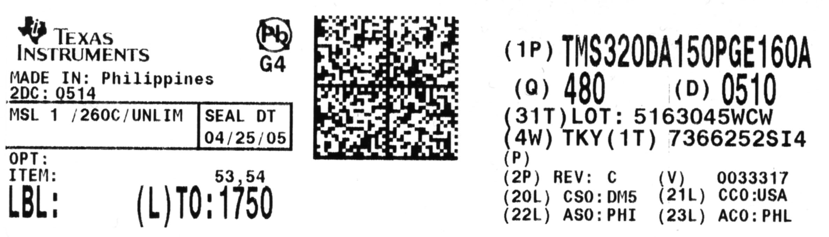
Overview
TQ (Transport Queue)/AutoTrack
1.2” x 4”
2D barcode
Data (printed/stored)
  TI Logo & Pb Free/RoHS Logo (if applicable)
  Made In
  2DC (2nd Date Code)
  2Q (2nd Quantity)
  Moisture Sensitivity
  Pb-Free / ECAT
  Option Text
  Item (SMS Item ID)
  Label Sequence Number
  Ship To Plant
  Device Name
  Quantity (Total)
  Date Code (Primary)
  SAP Batch
  State of Finish (SOF)
  STC (‘License Plate’)
  Customer Part Number
  Die Revision
  Vendor Number
  ASO/ACO
  CSO/CCO
Pack Label (Device)

Slide 12
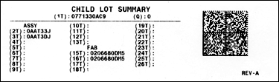
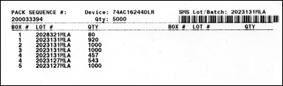
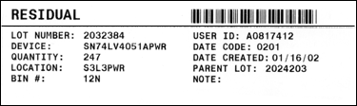
Overview
TQ (Transport Queue)/AutoTrack
Other Labels
Child Lot Summary
  Assembly Lot Trace Codes (LTC) and Fab Lot Trace Codes (FABLTC) contained in the box (package).
Pack Sequence
  Operator packing instructions indicating into which specific box each manufacturing lot must be packed.
Residual
  Label indicating in what BIN and LOCATION the residual inventory should be physically stocked.

Slide 13
Overview
TQ (Transport Queue)/AutoTrack
Pack Method
MJP (Multi/JIT Pack)
Boxes packed in full MOQ and full MJQ (multi-pack). Any remainder is split off as a residual lot. ADW demand is rounded up to MJQ.
HVP (High Volume Pack)
Boxes packed in full MOQ. The remainder is split off as a residual lot. ADW demand is rounded up to MOQ
LVP (Low Volume Pack)
Boxes packed in full MOQ. Remaining inventory is packed in full SPQ. Any additional inventory is split off as a residual lot. ADW demand is rounded up to SPQ.
SEP (Ship Everything Pack)
Packs as many boxes as possible in full MOQ. Remaining inventory is packed into full SPQ. Any additional inventory is packed into the last box. No lot splits are performed. ADW demand is not rounded and filled exactly as sent.
SLS/SLM (New Single Lot Processing implemented early 2007)
SLS – Single Lot/Single Box control
SLM – Single Lot/MOQ increment (1 Lot, Full Boxes/1 Partial) control

Slide 14
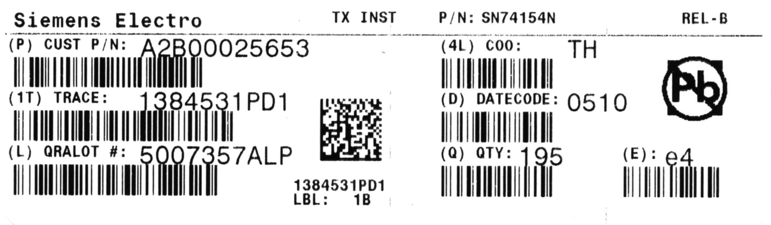
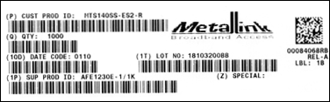
Overview
TQ (Transport Queue)/AutoTrack
Standard & Custom Upper Labels
Standard
Custom

Slide 15
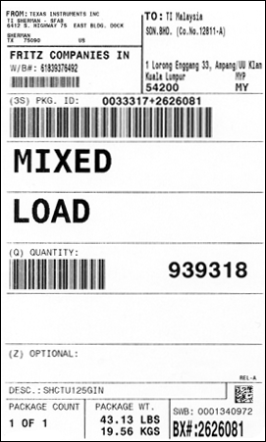
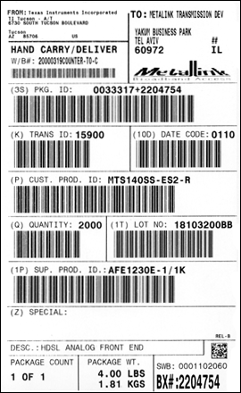
Overview
TQ (Transport Queue)/AutoTrack
Shipping Carton Labels
Standard
Custom

